Slide 1

FH
TECHNIKUM
WIEN
AI-Powered Agentic IDE
Architecture Development
& Documentation
Practical Evaluation
Alexander Nachtmann
Software Architecture
November 2025
Source: Kiro.dev © AWS | FH Technikum Wien | November 2025

Slide 2
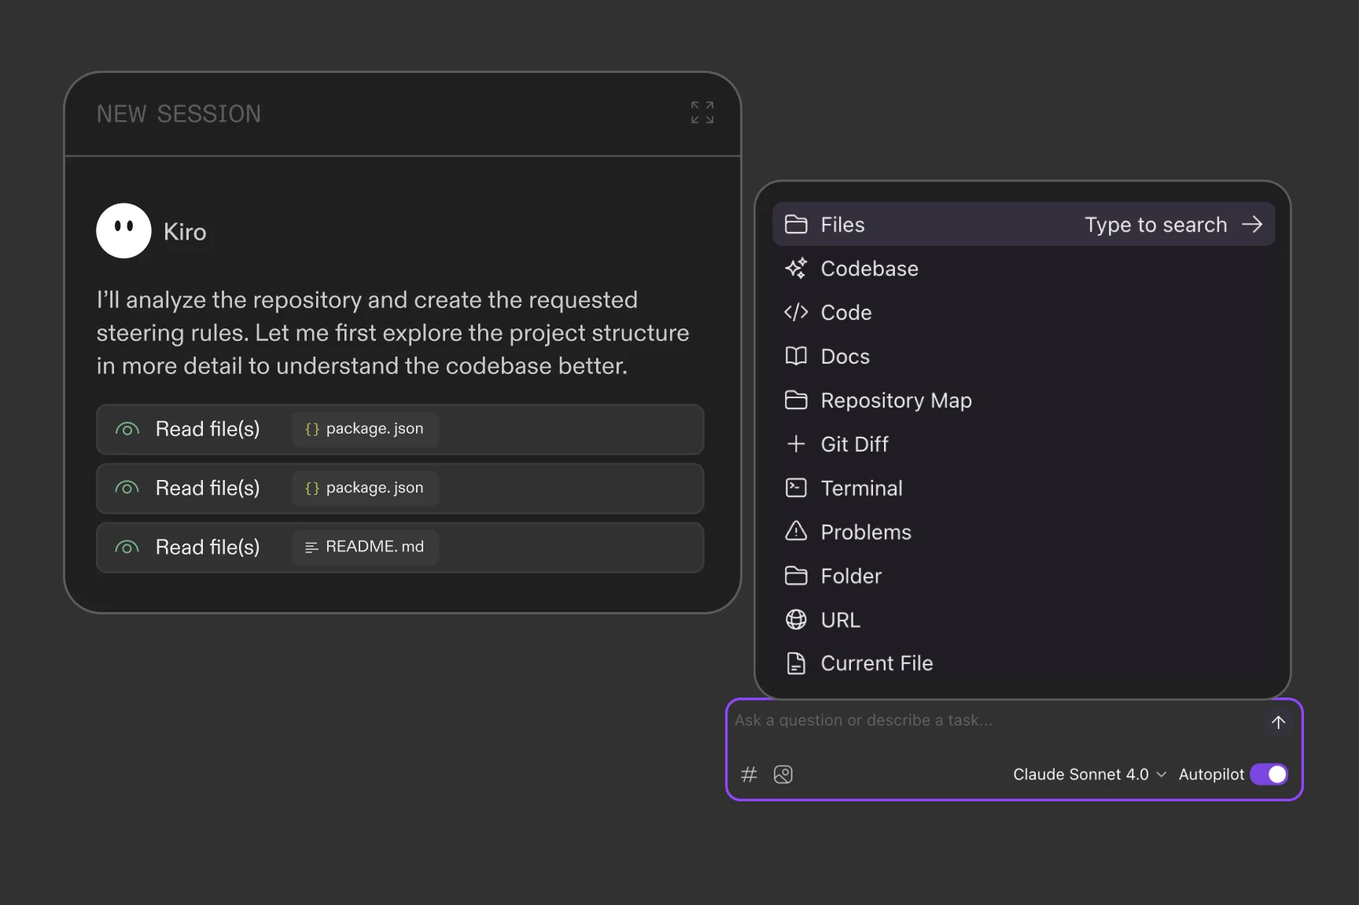
What is Kiro?
AWS AGENTIC IDE
Built by: AWS team
Released: July 2025
Based on: VS Code (Code OSS)
Philosophy:
"Development environment that
takes full advantage of AI"
Core Features:
• Spec-driven development
• Event-driven automation
• Multimodal input
• True AI collaborator
Source: Kiro.dev © AWS | FH Technikum Wien | November 2025

Slide 3
Core Concept: Spec-Driven Development
1
2
3
REQUIREMENTS
DESIGN
IMPLEMENTATION
requirements.md
User stories
EARS notation
Acceptance criteria
design.md
Architecture docs
Component diagrams
Sequence diagrams
tasks.md
Discrete tasks
Dependencies
Verification
→
→
✓ All three files linked - changing requirements automatically updates design & tasks
Source: Kiro.dev © AWS | FH Technikum Wien | November 2025

Slide 4
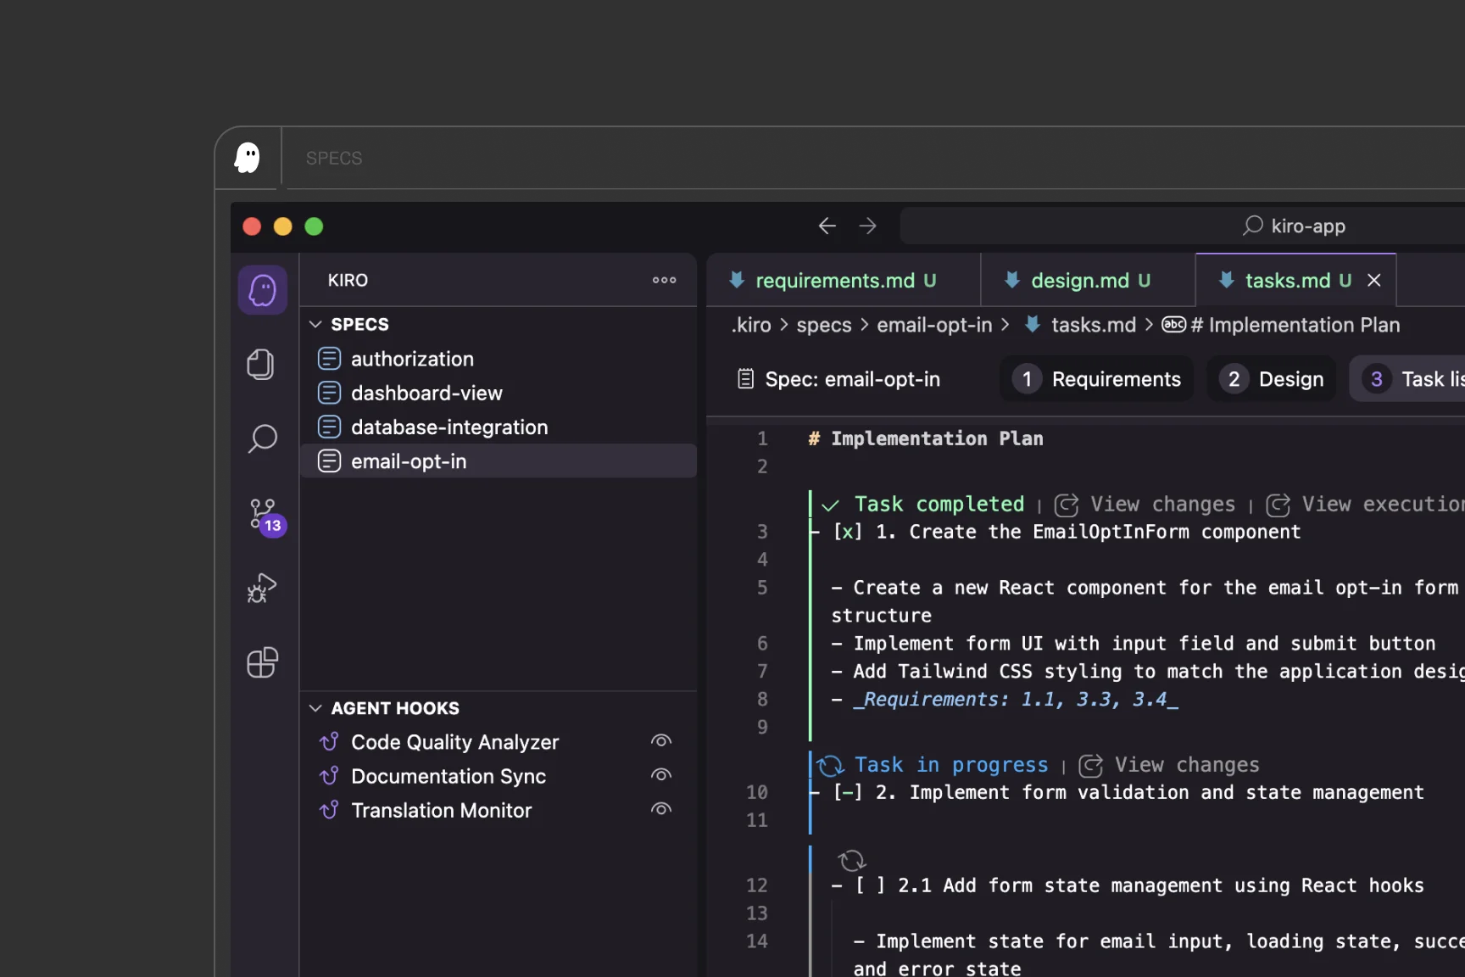
What Kiro Generates Automatically
📊
Component Diagrams
Mermaid/PlantUML • Git-versioned • Auto-updated on code changes
🔄
Sequence Diagrams
API call flows • System interactions • Error handling paths
📝
Architecture Decision Records (ADRs)
Context → Decision → Rationale → Consequences
🔗
Full Traceability Chain
Requirement → Design → Task → Test → Code
REAL EXAMPLE
Financial Trading System:
Whiteboard ERD → Complete architecture
(Kubernetes, PostgreSQL, Kafka) in minutes
Source: Kiro.dev © AWS | FH Technikum Wien | November 2025

Slide 5
Automation: Steering Files & Agent Hooks
STEERING FILES: Persistent AI Context
GLOBAL
~/.kiro/steering/
Personal
preferences
TEAM
via MDM/Git
Company
standards
WORKSPACE
.kiro/steering/
Project-
specific
AGENT HOOKS: Event-Driven Automation
File Save
→
Trigger
→
Agent Runs
→
Update Docs
Use Cases: Documentation sync • Test generation • Diagram updates • Security scans
Result: Documentation never falls behind code
Source: Kiro.dev © AWS | FH Technikum Wien | November 2025

Slide 6
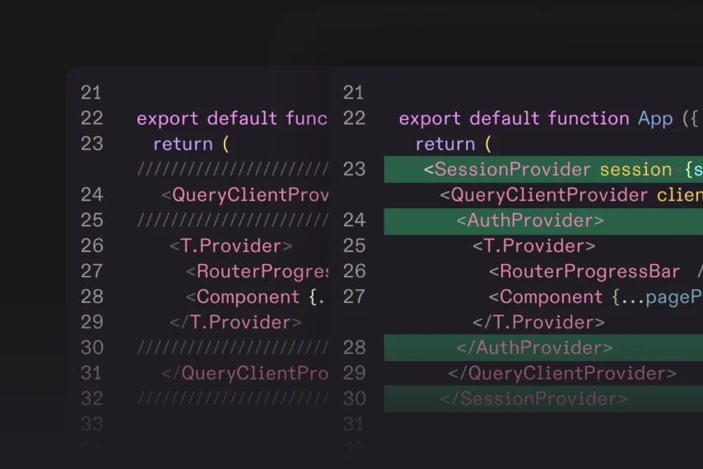
Extensibility: MCP Integration & Multimodal Input
MODEL CONTEXT PROTOCOL
MULTIMODAL INPUT
Connect external tools:
Local Servers:
• AWS documentation
• GitHub repositories
• Custom CLI tools
Remote (Oct 2025+):
• Company wiki
• Notion
• Issue trackers
Result: Enhanced AI context
for better code generation
Upload: Whiteboard → Architecture → UML
Source: Kiro.dev © AWS | FH Technikum Wien | November 2025

Slide 7
Real-World Workflow Example
Financial Trading System Development
1
WHITEBOARD
Draw ERD: User → Account → Position → Order → Trade
2
UPLOAD
Take photo, upload to Kiro
3
SPEC
Kiro generates requirements.md, design.md, tasks.md
4
IMPLEMENT
TypeScript models, PostgreSQL schema, Kubernetes manifests
5
AUTOMATE
Agent hooks: File save → Update OpenAPI + README
6
VALIDATE
Architecture constraints, compliance, security, performance
⚡ Result: Production-ready system in days instead of weeks
Source: Kiro.dev © AWS | FH Technikum Wien | November 2025

Slide 8
Practical Experience: Strengths (3.5 months)
🔗
INTEGRATION
Everything in one IDE • No context switching
📍
TRACEABILITY
Clear path REQ → CODE • Decisions documented
👥
CONSISTENCY
Standards enforced globally • Faster onboarding
⚡
AUTOMATION
Docs stay current • Background processing
🎨
VISUAL DESIGN
Whiteboard → Production code • Intent preserved
Source: Kiro.dev © AWS | FH Technikum Wien | November 2025

Slide 9
Practical Experience: Limitations
🔒
IDE LOCK-IN
Must use Kiro IDE (VS Code fork) • No JetBrains/Vim/Emacs
🆕
YOUNG ECOSYSTEM
Only 3.5 months old • Occasional breaking changes
⚙️
NO PROCESS ENFORCEMENT
No built-in TDD workflow • Relies on developer discipline
⏸️
SEQUENTIAL EXECUTION
Can't run multiple agents in parallel • One task at a time
✓ Mitigation: Use alongside process-focused tools for rigorous workflows
Source: Kiro.dev © AWS | FH Technikum Wien | November 2025

Slide 10
Conclusion: When to Use Kiro
PERFORMANCE RATINGS
✓ BEST FOR
Spec Generation
5/5
• Architecture-first development
• Documentation automation
• Compliance & traceability
• Visual design → code
Documentation Automation
5/5
Architecture Traceability
5/5
Multimodal Input
4/5
⚠ CONSIDER ALTERNATIVES
Process Enforcement
3/5
• Need IDE independence
• Require enforced TDD
• Need parallel execution
OVERALL: 4.2/5
KEY INSIGHT
Kiro excels at maintaining architecture documentation automatically.
Strongest feature: Keeping docs synchronized with code via agent hooks.
Try it: Free tier available • https://kiro.dev/docs
Source: Kiro.dev © AWS | FH Technikum Wien | November 2025

